Slide 1


Finger Reader
Faculty of Computers and Information
Assiut University

Slide 2
01
02
Table of Contents
03
04
Intro
Quick overview
Objective
Why we picked out this project?
Main Function
What our project really do?
Technical Overviwe
What tools we used?

Slide 3
01
Introduction

Slide 4
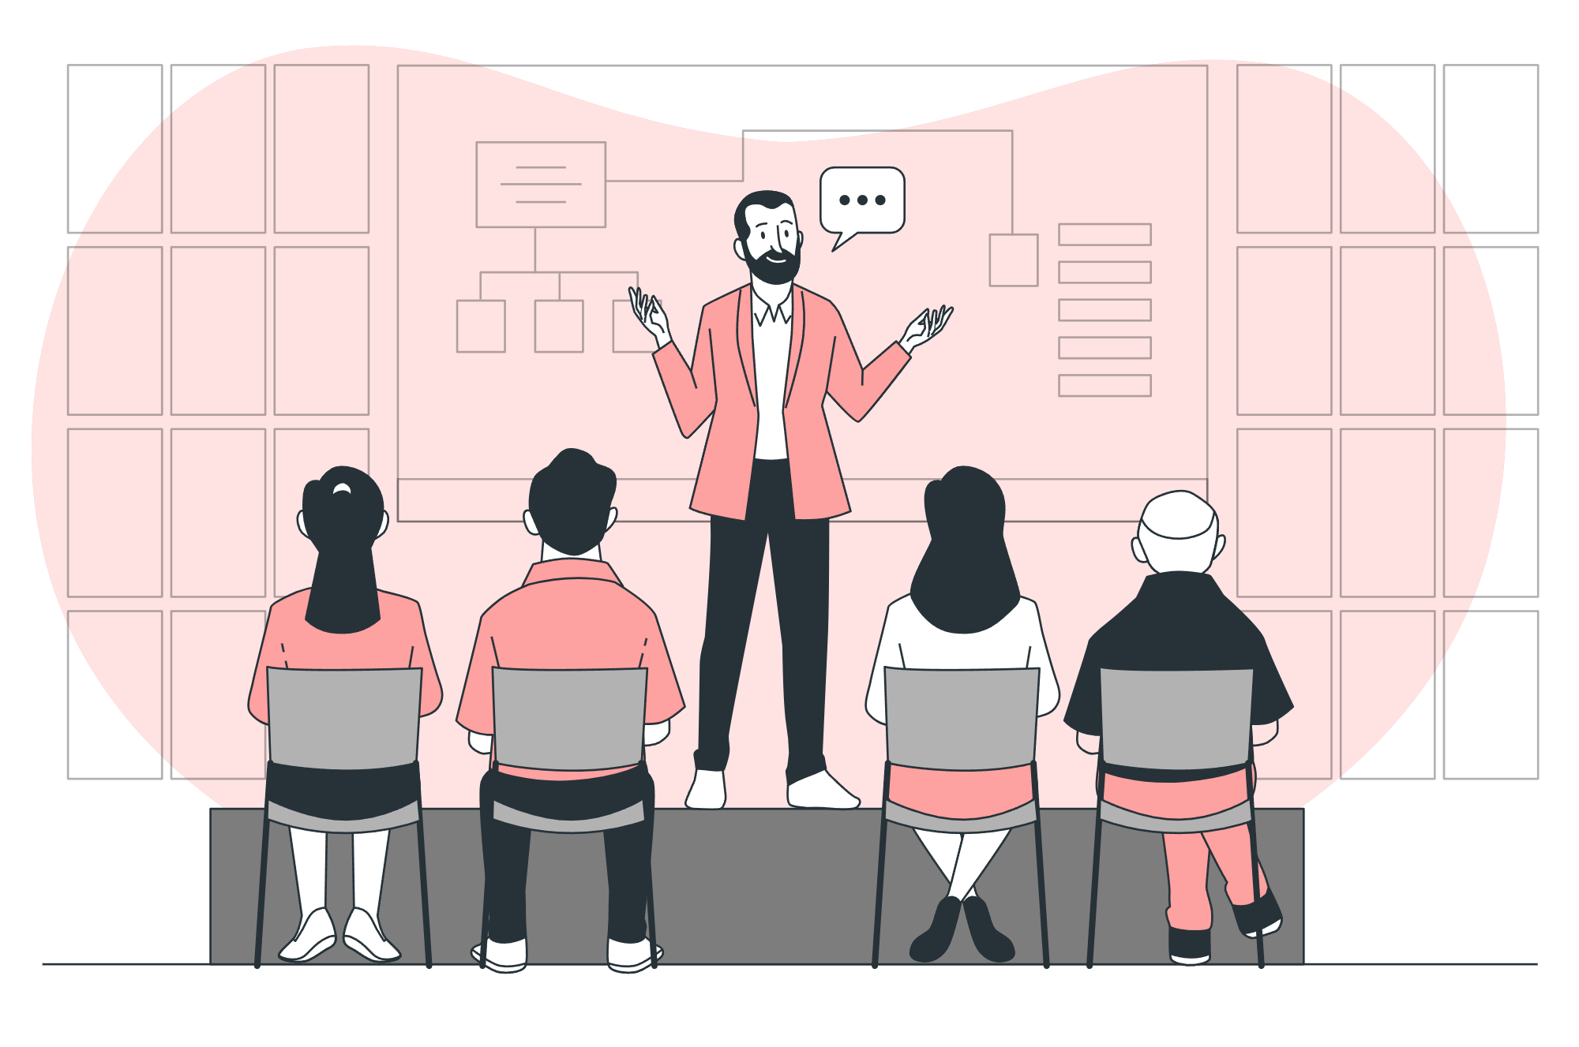
Accessing printed text in a mobile context is a major challenge for the blind, Braille is not available all the time in many countries including our beloved Egypt which includes official documents, books, newspapers, or even money, these reasons have led to a race in building technologies that can help blind people to overcome these challenges and live in more comfort, but current modern technologies have various downsides to consider including problems of alignment, focus, accuracy, mobility, and efficiency.

Slide 5
02
Objective

Slide 6

Our main goal is to create a portable, easy-to-use device that helps the blind and people with visual impairments to read text clearly and listen to it in the attached headphone without having to turn it into " Braille” and contribute to the vision of Egypt 2030 and improve the social and educational situation of the blind or visually impaired.
Facilitate reading text for people who cannot read because of illiteracy or dyslexia.

Slide 7
03
Main Function

Slide 8






Our Product Functions Overview
Detect finger
Line Deviation
learn the position of the finger to mark our ROI.
detects when the finger move up or down from the desired line.
Get Frames
Detect Word
Read Word
Get frames from ESP32 Cam
look for the first word to read to define current working line.
Finally, converts the desired text to speech that can be listened.

Slide 9
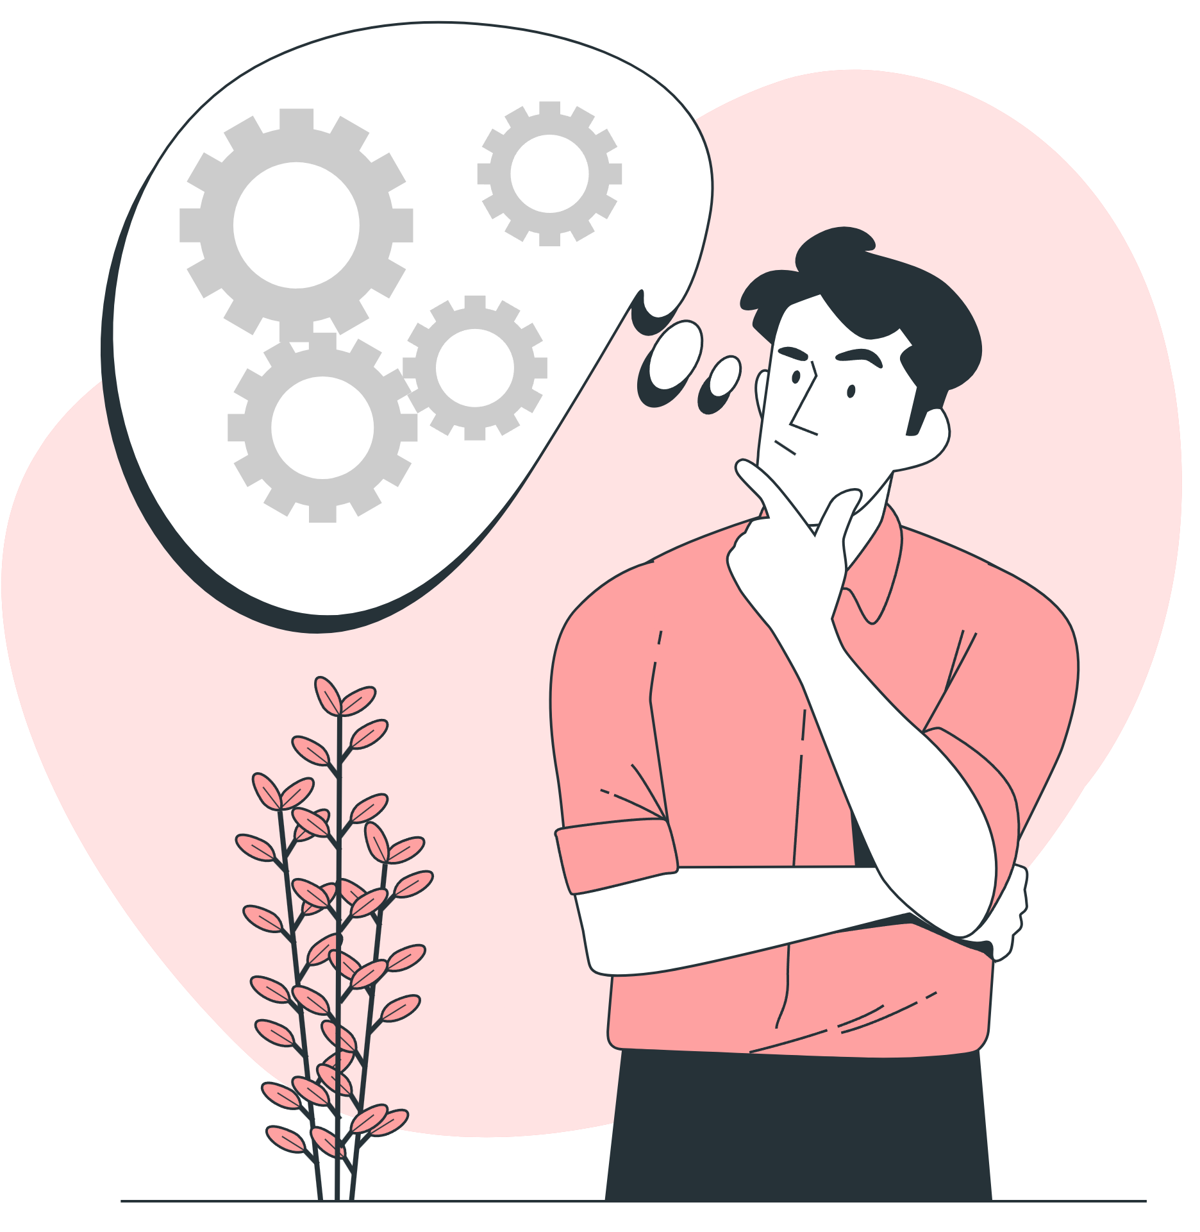
Under which branch do you think our project falls?

Slide 10


Two Main Branches
Computer Vision
Image Processing

Slide 11

What About Technologies we used !?

Slide 12





Software Details
Python
OpenCV
Pytesseract
pyttsx3
NumPy
Programming Language
It is mainly aimed at real-time computer vision
Library used to extract text from printed book, bills ...etc.
Is a text-to-speech conversion library in Python
Used to perform a wide variety of mathematical operations on arrays

Slide 13
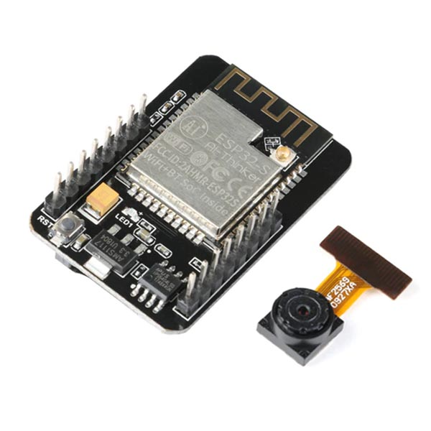
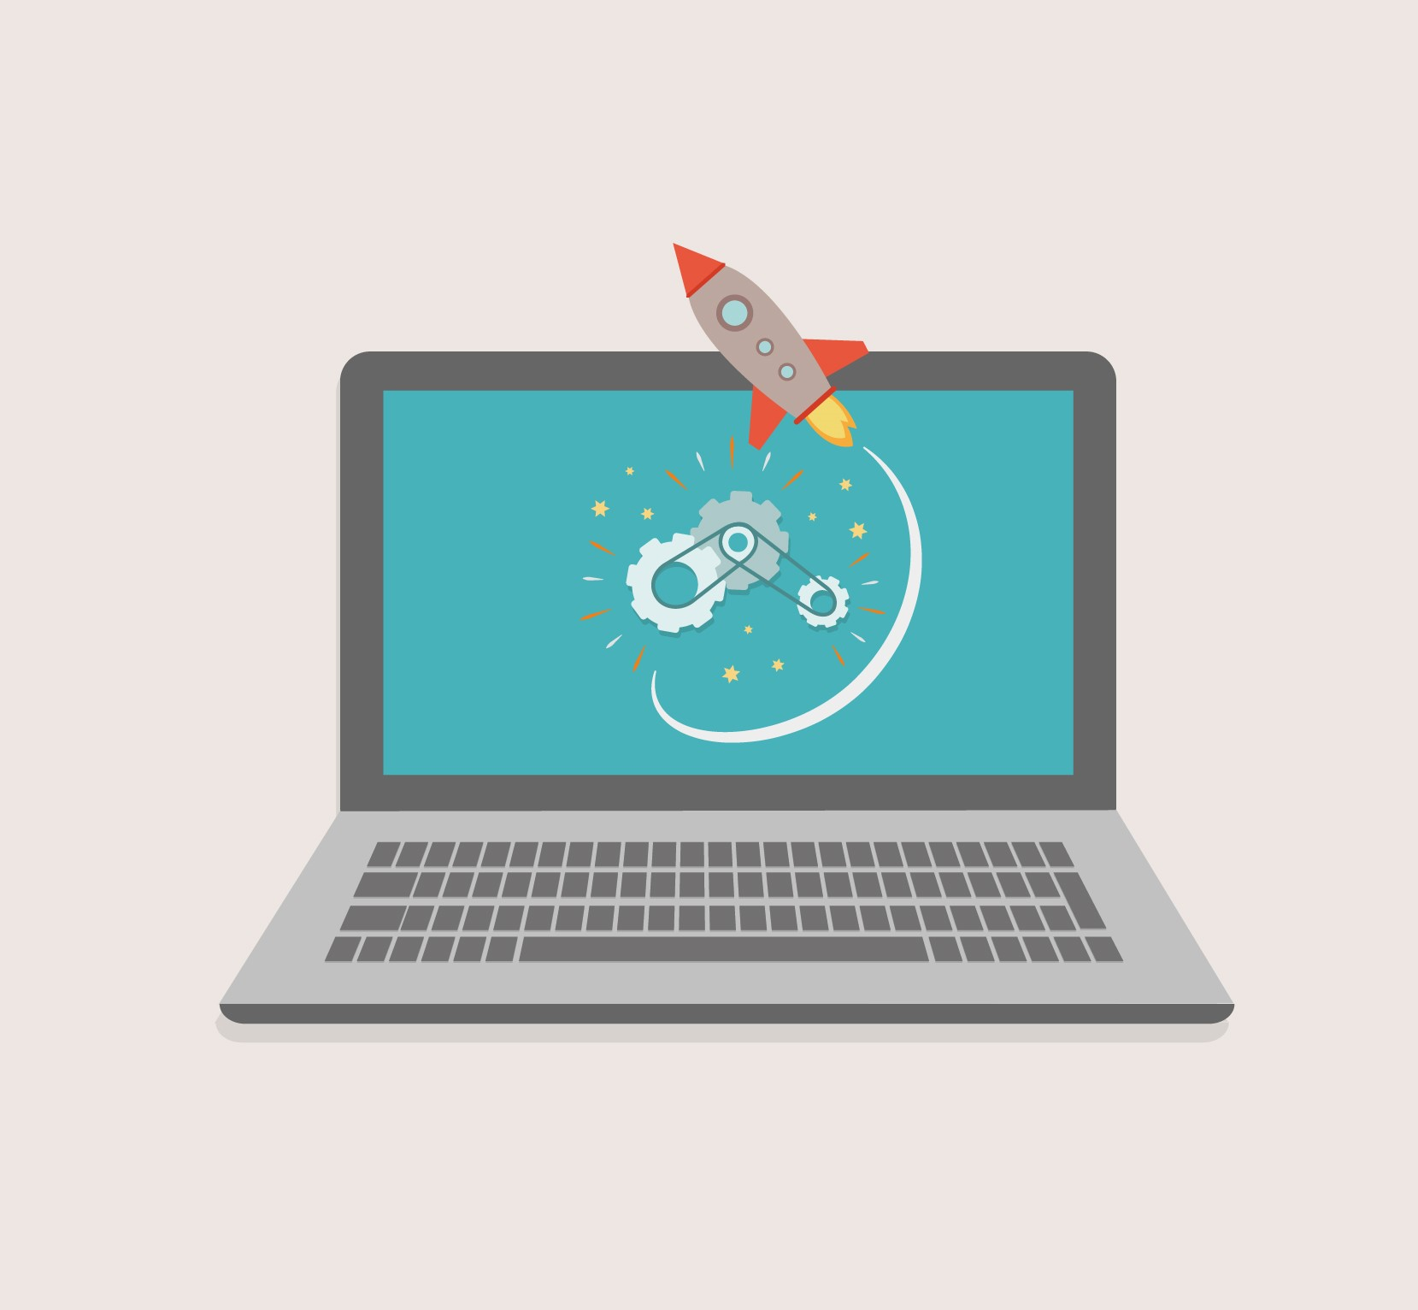
Hardware Details
Camera
Computing
ESP32-CAM Development Board – With Camera
Laptop acts as a computing computer

Slide 14
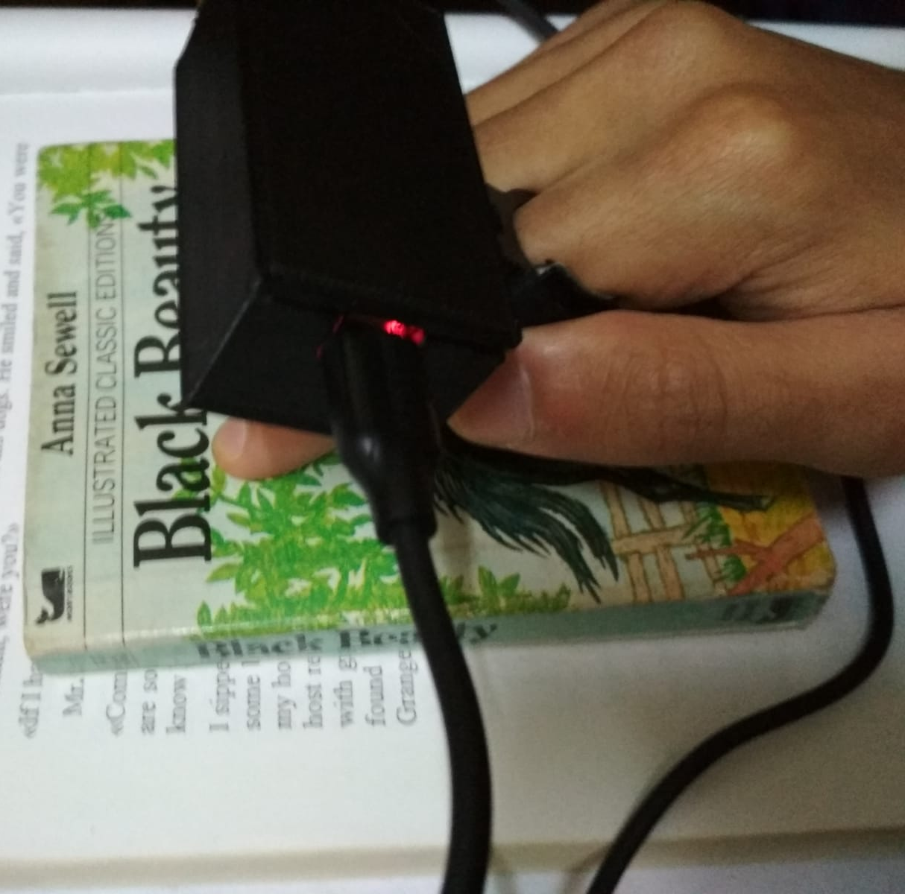
Our Final Product
Camera in the black box that connected with ring

Slide 15
Meet Our Team
Muhammad Medhat Abdel-Rady
Muhammad Ehab Muhammad
Amr Muhammad Gaber
Reen Osama Abdel-Menem
Habeba Allah Adnan

Slide 16
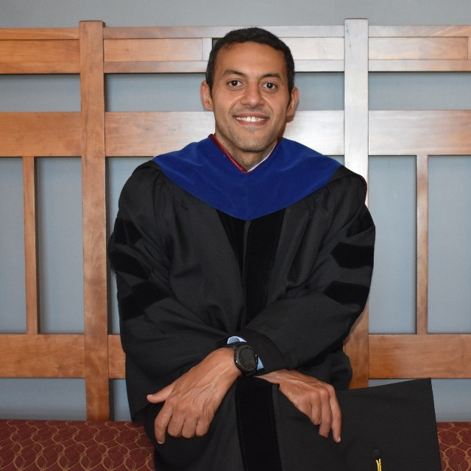
Dr/ Mustafa Kamel
Ph.D., Computer Science - Faculty of Engineering - Virginia Tech - USA

Slide 17


Thanks!
Do you have any questions?
You can also see our progress and tries in GitHub ..!!

